Slide 1
Organizational Design Structure, Size & technology
Cdr. Vijay Pratap Singh, Adjunct Professor, E&TC

Slide 2
Organizational Design
According to Sargent & McConnell, ”Organisational Design can be defined as a process for improving the probability that an organization will be successful by assessing and reshaping structure and position to better meet (Business) goals”.
According to Richard M. Burton, ”Organizational design is the body of knowledge and techniques that seeks to offer useful advice to organizations about their structures (and other aspects) needed to attain their goals.”

Slide 3
Features of Organisational Design
Getting work Done
Accomplishing Organisational Goals
Ways of Integration
Matching Strategic Actions
Determining Organisational Structure
Resource Allocation

Slide 4





Importance of Organisational Design
Importance of Organisational Design
Dealing with Contingencies
Gaining Competitive Advantage
Managing Diversity
Efficiency & Innovation
Provides Clarity

Slide 5




Approaches for Organisational Design
Process Approach
Result Approach
Decision Approach

Slide 6
Organisational Structure
According to Koontz and Donnel, “Organisation structure is the establishments of authority relationships with provision for coordination between them, both vertically and Horizontally in the enterprise structure.

Slide 7













Features of Organisational Structure
Features of Organisational Structure
Simplicity
Flexibility
Clear Line of Authority
Application of Ultimate Responsibility
Proper Delegation of Authority
Minimum Possible Managerial Levels
Principles of Unity of Directions and Command
Proper Emphasis on Staff
Provisions for Top Management

Slide 8
Elements of Organisational Structure
Work Specialisation
Departmentalisation
Chain of Command
Unity of Command
Span of Management
Centralisation and Decentralisation
Formalisation

Slide 9

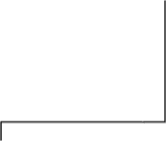



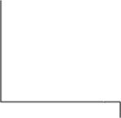






Types of Organisational Structure
Types of Organisational Structure
Line & Staff Organisation
Line Organisation
Functional
Organisation
Divisional
Organisation
Project Organisation
Matrix Organisation

Slide 10
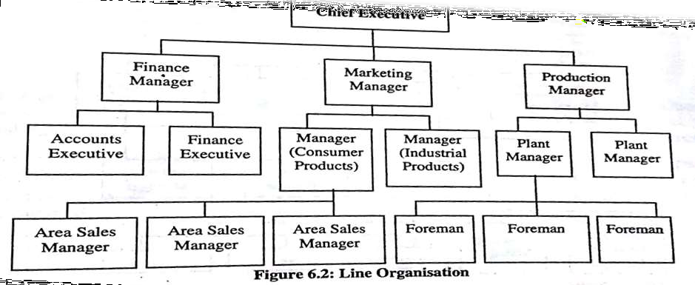
Line Organisation:

Slide 11
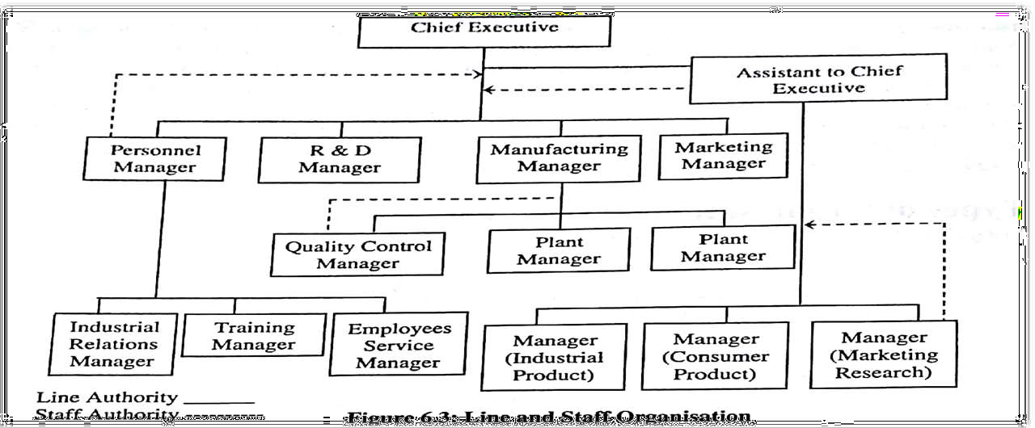
Line and Staff Organisation:

Slide 12
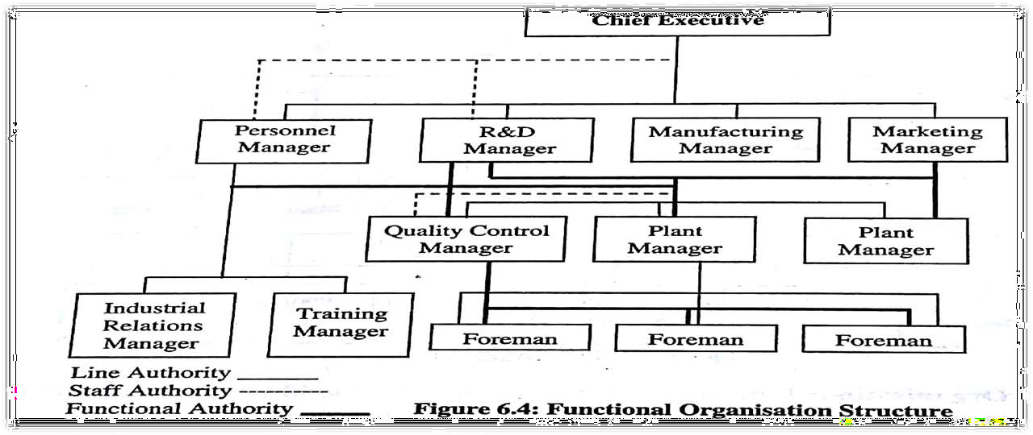
Functional Organisation Structure:

Slide 13
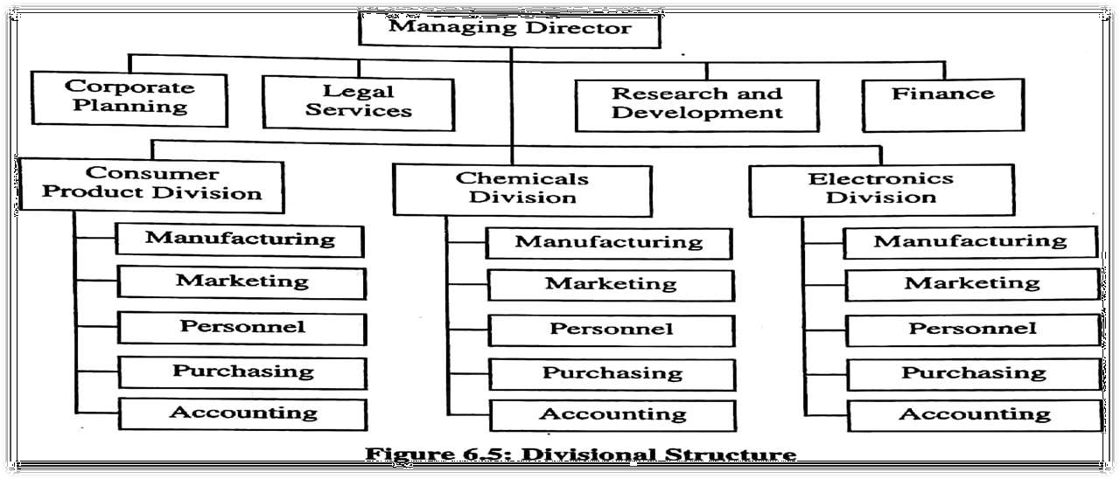
Divisional Structure:

Slide 14
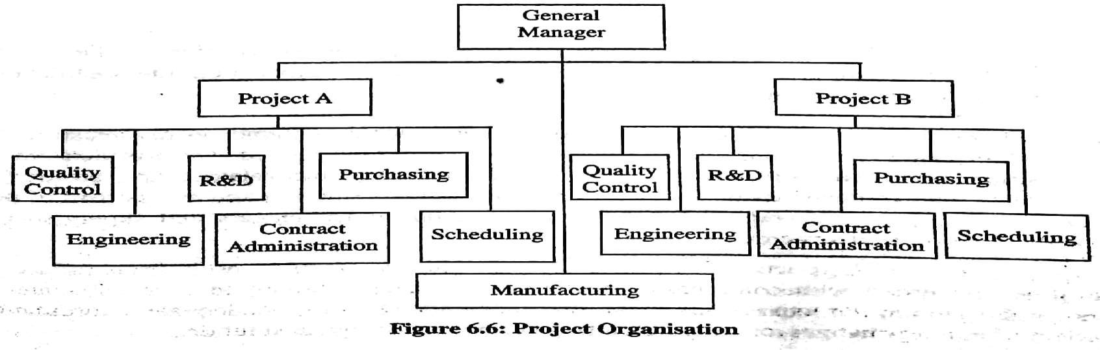
Project Organisation:

Slide 15
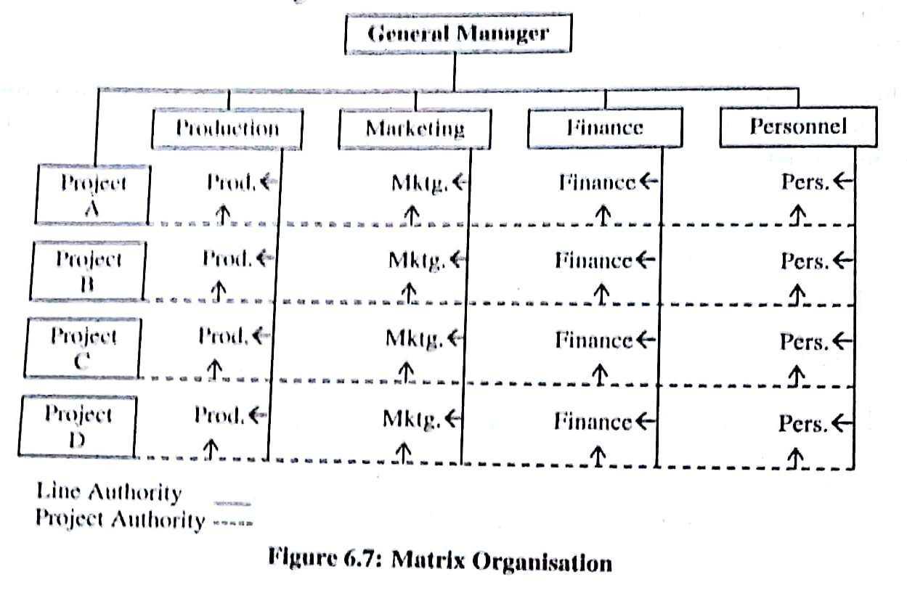
Matrix Organisation:

Slide 16
Organisational Structure & It’s Impact on Organisational Behavior
When the Organisational structure is not properly designed, the basic effects on Organisation & Employees are as follows:-
Low Motivation and Morale
Poor Response to New Opportunities and External Change
Decision Making is Delayed or Lacking in Quality
Too much conflict is evident

Slide 17
Formation of Organisational Structure
Determination of Organisational Goals & Identification of Related Activities
Grouping of Activities
Delegation of Authority

Slide 18









Importance of Organisational Structure
Importance of Organisational Structure
coordination
Source of Support & Security
Chain of Command
Decision-Making

Slide 19
Organisational size:
Organisational size defined as total number of employee . when a larger organisation more complicated structure. When organisation is small ex: single retail store..
The increase the size may give rise to following structural characteristics:

Slide 20
High vertical differentiation
High horizontal differentiation
Increase in specialisation of skill and function
High degree of formalisation

Slide 21


Technology
Technology is the way tasks are accomplished using tools, equipment , techniques and human know-how. Every technology uses some from transform inputs into outputs.
in early 1960s, Joan Woodward found that right combination and technology were as following
Small production
Mass production
Continuous production

Slide 22


